Slide 1
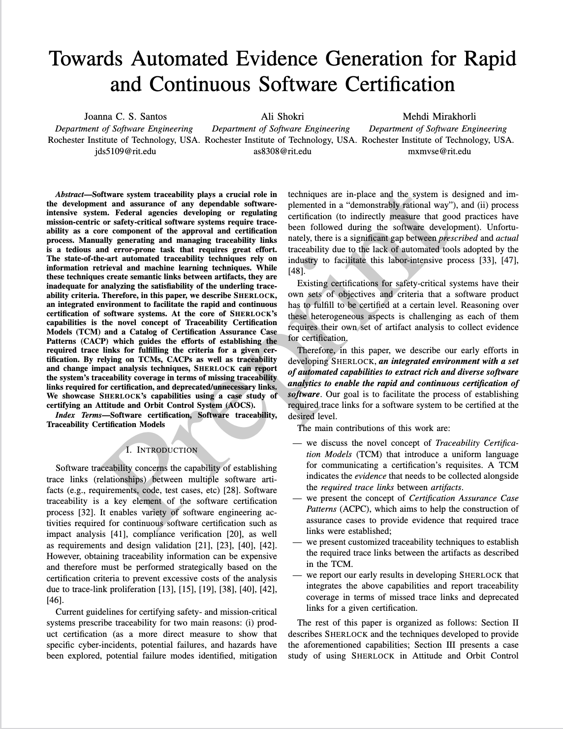

Slide 2
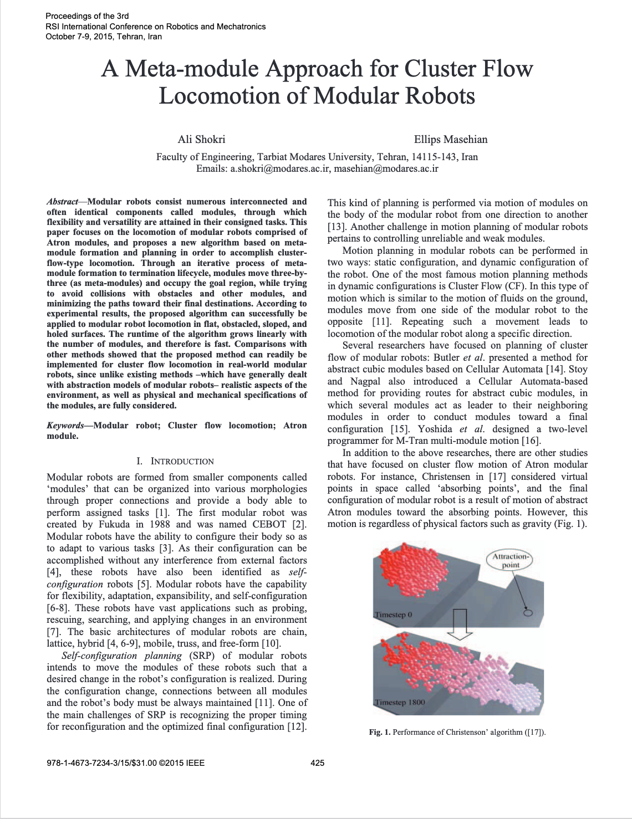

Slide 3
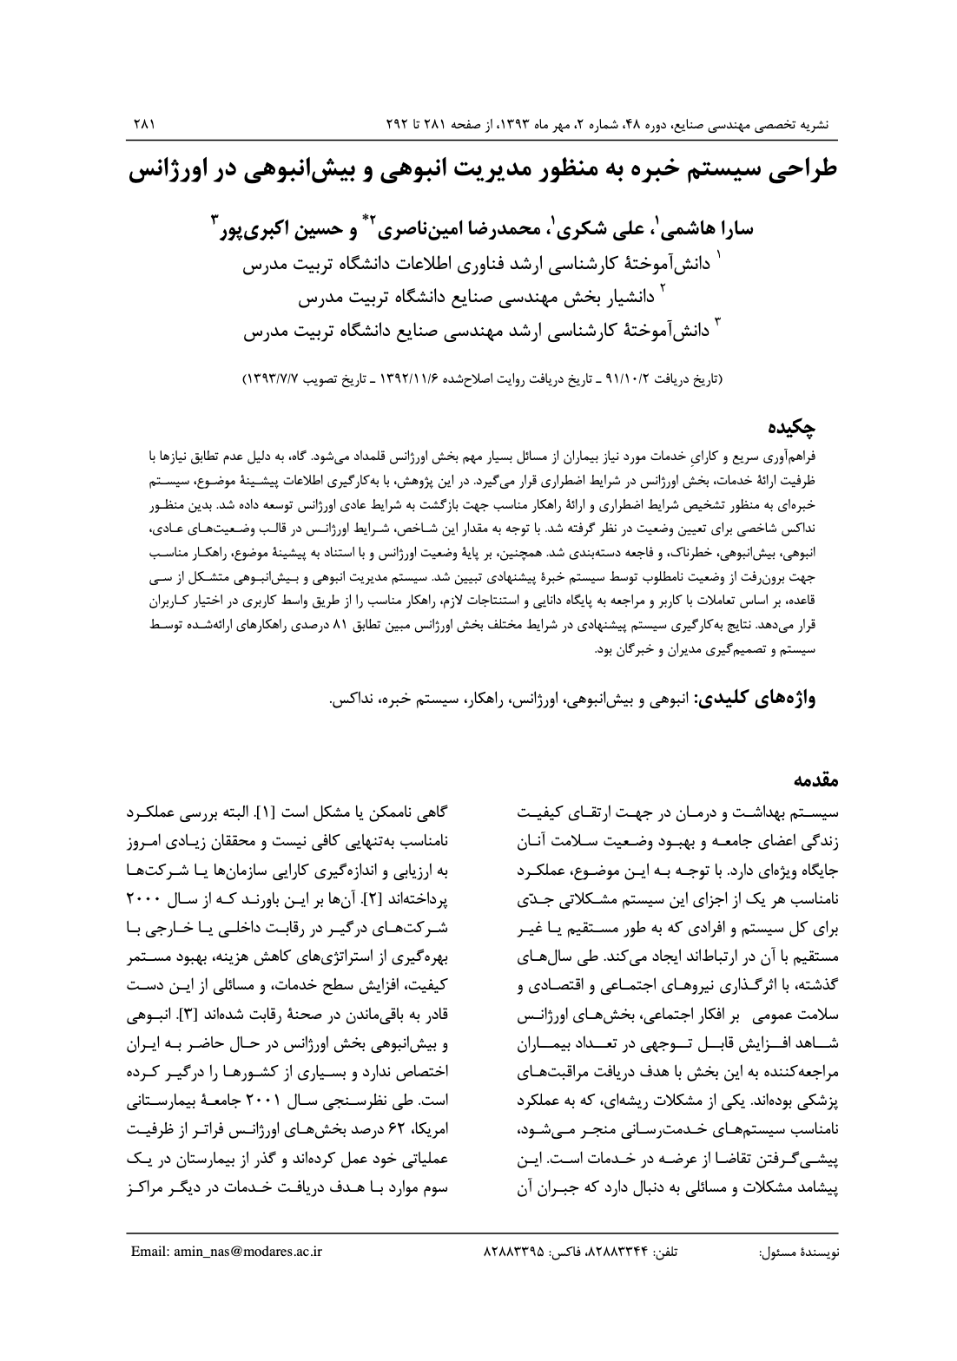

Slide 4
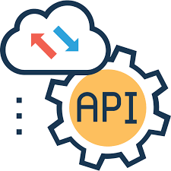

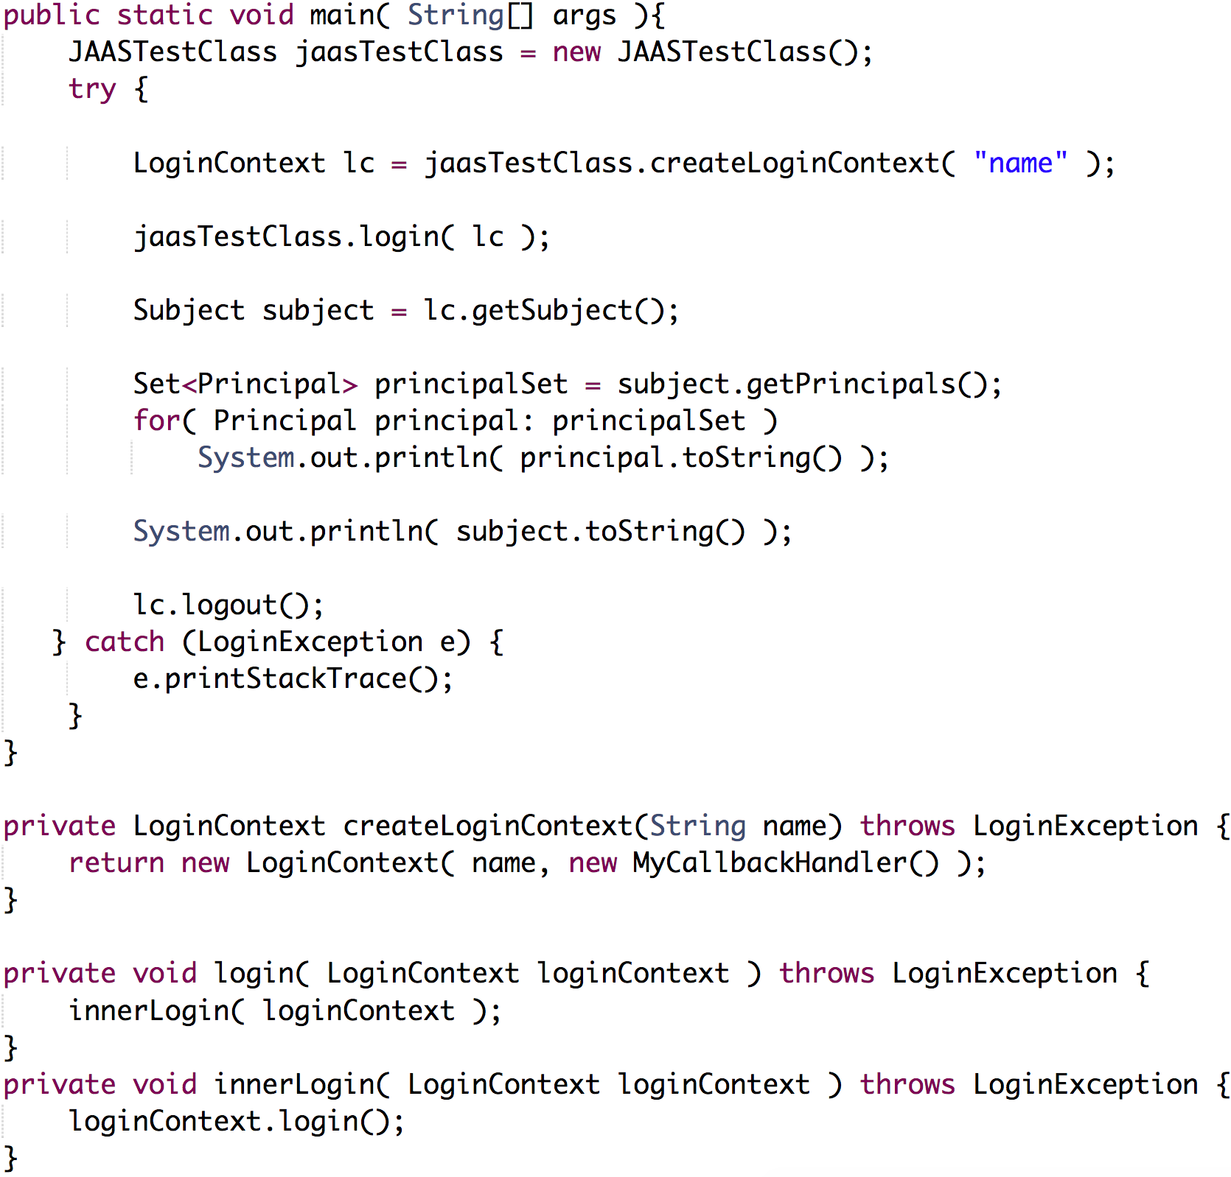



Incomplete Program Specification
Framework API
Program Analysis & API Usage Extraction
API Usage Patterns
Component-based Program Synthesis
Synthesized Program
Code Repositories

